Slide 1

SCHOOL OF COMPUTING
DEPARTMENT OF COMPUTING TECHNOLOGIES 18CSP109L - MAJOR PROJECT
SRM INSTITUTE OF SCIENCE AND TECHNOLOGY
An Approach for Prediction of Loan Approval using Ml algorithm
Batch ID : 202
Student 1 Reg. No: RA1911003010072 Student 1 Name: P.S.A.BHASKAR REDDY
Guide name: Dr.R.S.PONMAGAL
Designation: ASSOCIATE PROFESSOR
Student 2 Reg. No: RA1911003010113 Student 2 Name: GNANESWAR REDDY.M
Department: CTECH

Slide 2
ABSTRACT
With the upgrade in the financial area,loads of individuals are applying for bank advances however the bank has its restricted resources which it needs to allow to restricted individuals. So discovering to whom the credit can be conceded which will be a more secure choice for the bank is a common place interaction.
So in this task we attempt to decrease this danger factor behind choosing the protected individual in order to save bunches of bank endeavors and resources.
This is finished by mining the Data of the past records of individuals to whom the advance was conceded previously and based on these records/encounters the machine was prepared utilizing the model which give the most precise outcome.
This project is separated into four areas (i)Data Collection (ii)Comparison of ML models on gathered information (iii)Training of framework on most encouraging model (iv)Testing.

Slide 3
INTRODUCTION
This task has taken the information of past clients of different banks to whom on a bunch of boundaries credit were approved. So the AI model is prepared on that record to get precise outcomes.
Our fundamental target of this exploration is to anticipate the security of credit. To foresee advance well being, the strategic relapse calculation is utilised.
First the information is cleaned in order to stay away from the missing qualities in the informational collection.
To prepare our model informational collection of 1500 cases and 10 mathematical and 8 downright characteristics has been taken.
To credit an advance to client different boundaries like CIBIL Score (Credit History), Business Value.

Slide 4
MOTIVATION
Loan approval is a very important process for banking organizations. The system approved or reject the loan applications. Recovery of loans is a major contributing parameter in the financial statements of a bank. It is very difficult to predict the possibility of payment of loan by the customer. Using Machine learning we predict the loan approval.
Objective
The objective is implemented using the software package. This proposed model provides the important information with the highest accuracy. It is used to predict the loan status in commercial banks using machine learning classifier.

Slide 5
EXISTING SYSTEM
Abhilash had suggested a method for approving using a decision tree to forecast loans. One of the most used models is the decision tree and very useful Regression algorithm.
To decide whether to divide a bump into two or more sub- knots, decision trees employ a variety of strategies. Future sub-knot formation becomes simpler. As a result, we can state that the bump's chasteness grows in connection to the desired variable.
DISAdvantageS OF EXISTING SYSTEM
Less accuracy
Less efficiency
Problem in prediction
It’s not a web based application

Slide 6
PROPOSED SYSTEM
Banking Industry always needs a more accurate predictive modeling system for any issues. Predicting credit defaulters is a difficult task for the banking industry.
The loan status is one of the quality indicators of the loan. It doesn’t show everything immediately, but it is a first step of the loan lending process.
The loan status is used for creating a credit scoring model. The credit scoring model is used for accurate analysis of credit data to find defaulters and valid customers.
The objective of this project is to create a credit scoring model for credit data. Various machine learning techniques are used to develop the financial credit scoring model.
In this project, we propose a machine learning classifier-based analysis model for credit data. We used Logistic Regresssion Algorithm.

Slide 7
ADVANTAGES OF PROPOSED SYSTEM
Simple UI
Time Efficient
Great accuracy
It’s a web based application
It gives perfect result

Slide 8
LITERATURE SURVEY
S.N0 | AUTHOR | YEAR OF PUBLISH | TITLE | ADVANTAGE | DISADVANTAGE
1 | Mohammad Ahmad Sheikh, Amit Kumar Goel, TapasKumar | 2019 | An Approach for Prediction of Loan Approval using Machine Learning Algorithm | Once it is detected with the particular parameters, the system will predict the loan status | Low accuracy
2 | Bhoomi Patel1, Harshal Patil2, Jovita Hembram3, Shree Jaswal | 2021 | Loan Default Forecasting using Data Mining | When the developed model applies with the Prediction, the system can be detected loan status | As a result, they found 68% accuracy
3 | G. Arutjothi,Dr. C. Senthamarai | 2020 | Prediction of Loan Status in Commercial Bank using Machine Learning Classifier | Strong pre-processing techniques. | It not detect with accurate system.

Slide 9
LITERATURE SURVEY
S.NO | AUTHOR | YEAR OF PUBLISH | TITLE | ADVANTAGE | DISADVANTAGE
4 | Xin Li, Xianzhong Long, Guozi Sun, Geng Yang, and Huakang Li | 2020 | Overdue Prediction of Bank Loans Based on LSTM-SVM | Algorithms and work on huge dataset with strong pre-processing techniques. | Low accuracy and not accurate prediction
5 | Dawei Cheng, Zhibin Niu†, Yi Tu and Liqing Zhang | 2021 | Prediction Defaults for Networked-guarantee Loans | Strong pre-processing techniques. | It not detect with accurate system.
6 | Jian HU, Zibo, China | 2022 | Personal Credit Rating Using machine learning Technology for the National Student Loans | High accuracy | Weak technology used

Slide 10
LITERATURE SURVEY
S.NO | AUTHOR | YEAR OF PUBLISH | TITLE | ADVANTAGE | DISADVANTAGE
7 | Haengju Lee, Nathan Gnanasambandam, Raj Minhas, and Shi Zha | 2019 | Dynamic Loan Service Monitoring using Segmented Hidden Markov Models | new realized data is added to the current historical data | Low accuracy and not accurate prediction
8 | Khaldoon Alshouiliy, Ali Al Ghamdi, Dharma P Agrawal | 2021 | Azure ML Based Analysis and Prediction Loan Borrowers Creditworthy | The time series sequence data | Not a accurate prediction because of improper models
9 | Girija Attigeri, Manohara Pai M M*, Radhika M Pai | 2022 | Analysis of Feature Selection and Extraction Algorithm for Loan Data: A Big Data Approach | Club datasets to make it well understood datasets features. | Low accuracy
10 | Tiara Fajrin, Ragil Saputra, Indra Waspada | 2018 | Credit Collectibility Prediction of Debtor Candidate Using Dynamic K-Nearest Neighbor Algorithm and Distance and Attribute Weighted | Predict Fraudulent activities in financial institutes | Financial data not comes from various sources and forms

Slide 11
INNOVATION IDEA OF THE PROJECT
This project provides a solution to automate this process by employing machine learning algorithm. So the customer will fill an online loan application form. This form consist details like Gender, Marital Status, Qualification, Details of Dependents, Annual Income. Especially we are proceeding with credit score for loan approval and it’s web based application.

Slide 12
SCOPE AND APPLICATION OF THE PROJECT
Banks, Housing Finance Companies deal in various types of loans like housing loan, personal loan, business loan etc in all over the part of countries. These companies have existence in Rural, Semi Urban and Urban areas. After applying loan by customer these companies validates the eligibility of customers to get the loan or not. This project provides a solution to automate this process by employing machine learning algorithm. So the customer will fill an online loan application form. This form consist details like Gender, Marital Status, Qualification, Details of Dependents, Annual Income, Amount of Loan, Credit History of Applicant and others

Slide 13
PROPOSED MODULES
Data Collection
Data Pre-Processing
Feature Extraction
Spliting into training set
Spliting into testing set
Model Evaluation
Prediction

Slide 14
ALGORITHM DESCRIPTION
LOGISTIC REGRESSION
Logistic regression is one of the most popular Machine Learning algorithms, which comes under the Supervised Learning technique. It is used for predicting the categorical dependent variable using a given set of independent variables.
Logistic regression predicts the output of a categorical dependent variable. Therefore the outcome must be a categorical or discrete value. It can be either Yes or No, 0 or 1, true or False, etc. but instead of giving the exact value as 0 and 1, it gives the probabilistic values which lie between 0 and 1.
Logistic Regression is much similar to the Linear Regression except that how they are used. Linear Regression is used for solving Regression problems, whereas Logistic regression is used for solving the classification problems.

Slide 15
In Logistic regression, instead of fitting a regression line, we fit an "S" shaped logistic function, which predicts two maximum values (0 or 1).
The curve from the logistic function indicates the likelihood of something such as whether the cells are cancerous or not, a mouse is obese or not based on its weight, etc.
Logistic Regression is a significant machine learning algorithm because it has the ability to provide probabilities and classify new data using continuous and discrete datasets.

Slide 16
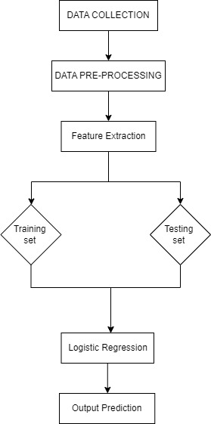
UML DIAGRAMS
ARCHITECTURE diagram

Slide 17
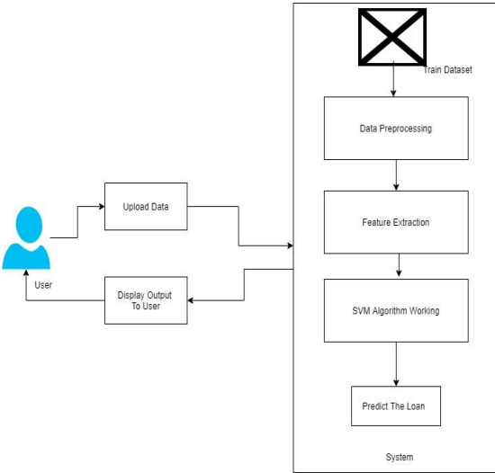
UML DIAGRAMS
DATA FLOW DIAGRAM
Logestic Regression

Slide 18
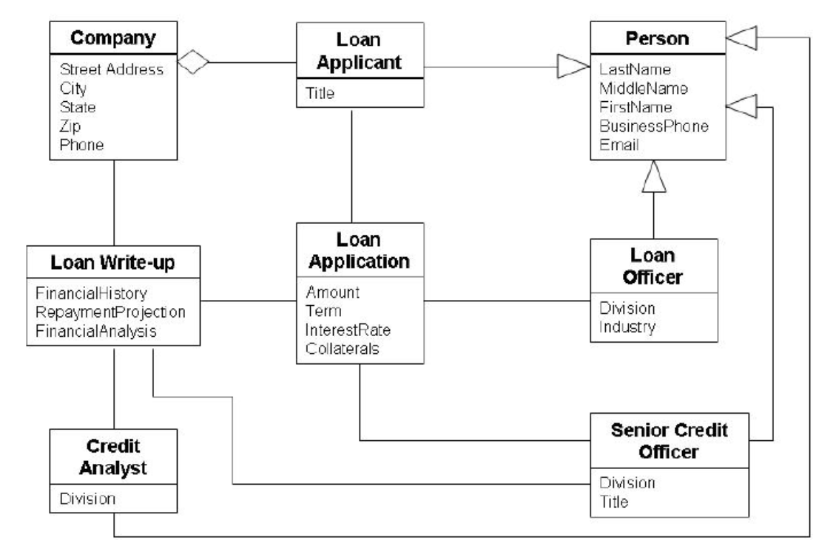
UML DIAGRAMS
CLASS DIAGRAM

Slide 19
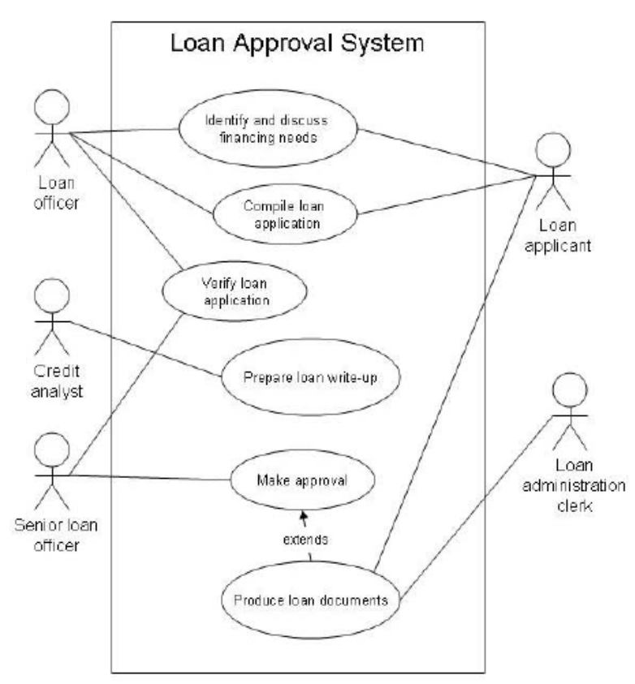
UML DIAGRAMS
USE CASE DIAGRAM

Slide 20
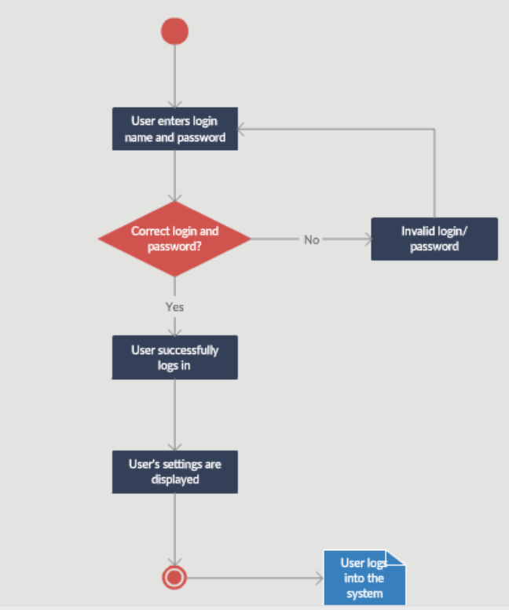
UML DIAGRAMS
ACTIVITY DIAGRAM

Slide 21
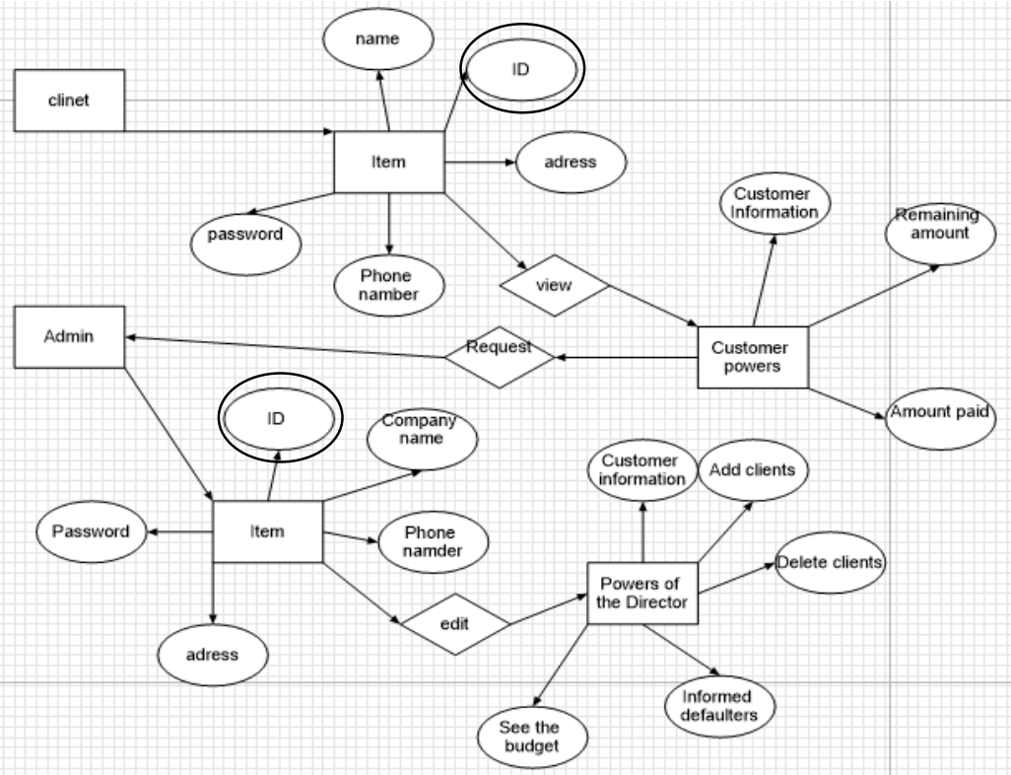
UML DIAGRAMS
ENTITY RELATIONSHIP DIAGRAM

Slide 22
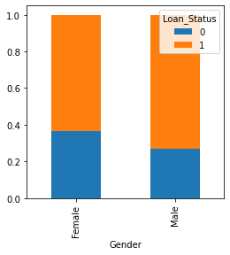
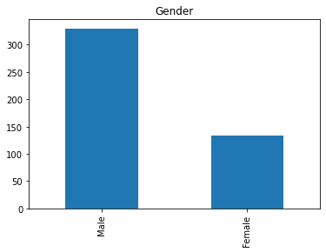
OUTPUT SCREENSHOTS
Initial
Final

Slide 23
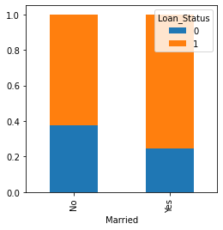
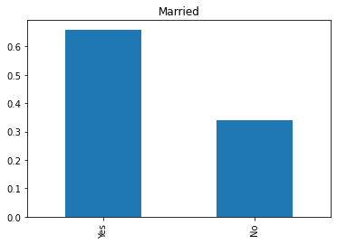
OUTPUT SCREENSHOTS
Initial
Final

Slide 24
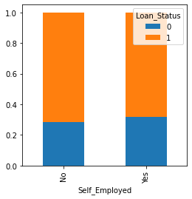
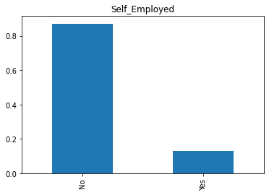
OUTPUT SCREENSHOTS
Initial
Final

Slide 25
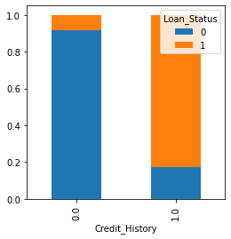
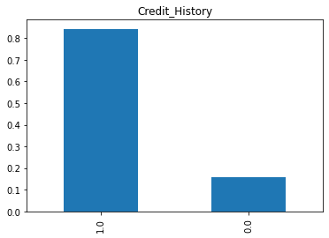
OUTPUT SCREENSHOTS
Initial
Final

Slide 26
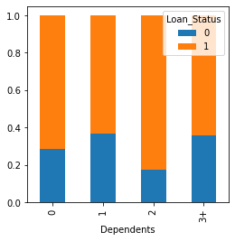
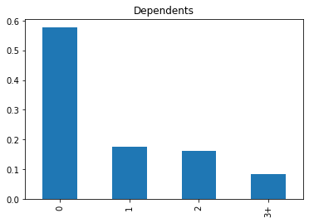
OUTPUT SCREENSHOTS
Initial
Final

Slide 27
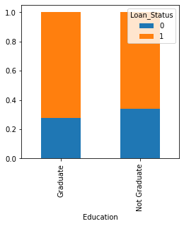
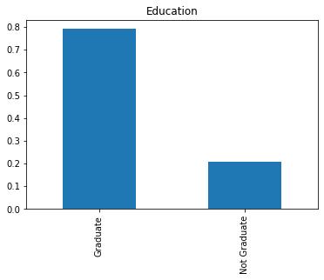
OUTPUT SCREENSHOTS
Initial
Final

Slide 28
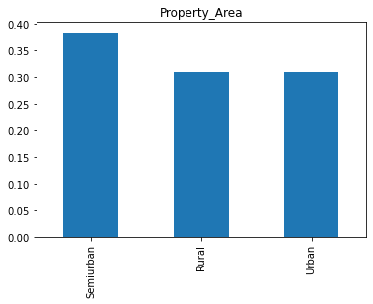
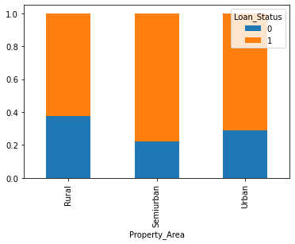
OUTPUT SCREENSHOTS
Initial
Final

Slide 29
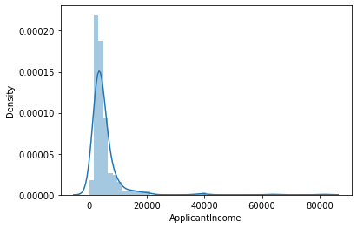
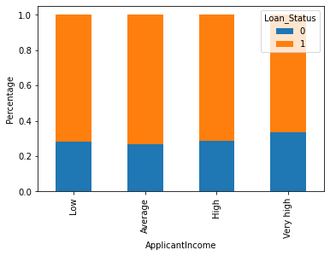
OUTPUT SCREENSHOTS
Initial
Final

Slide 30
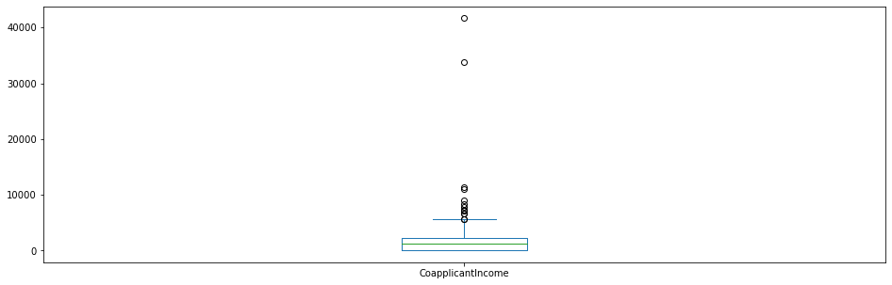
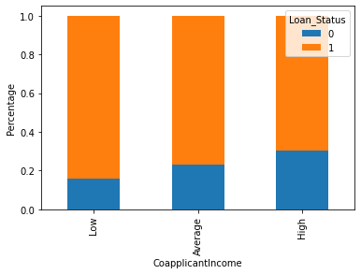
OUTPUT SCREENSHOTS
Initial
Final

Slide 31
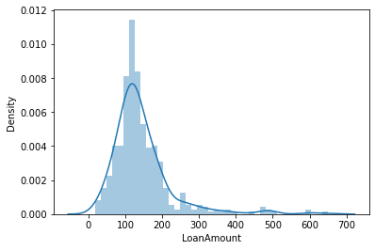
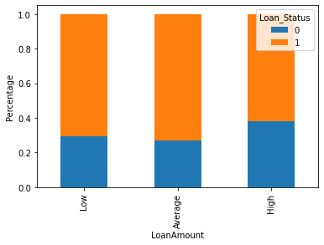
OUTPUT SCREENSHOTS
Initial
Final

Slide 32
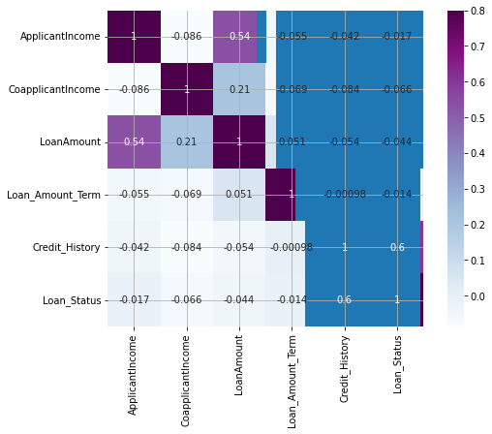
CONFUSION MATRIX

Slide 33
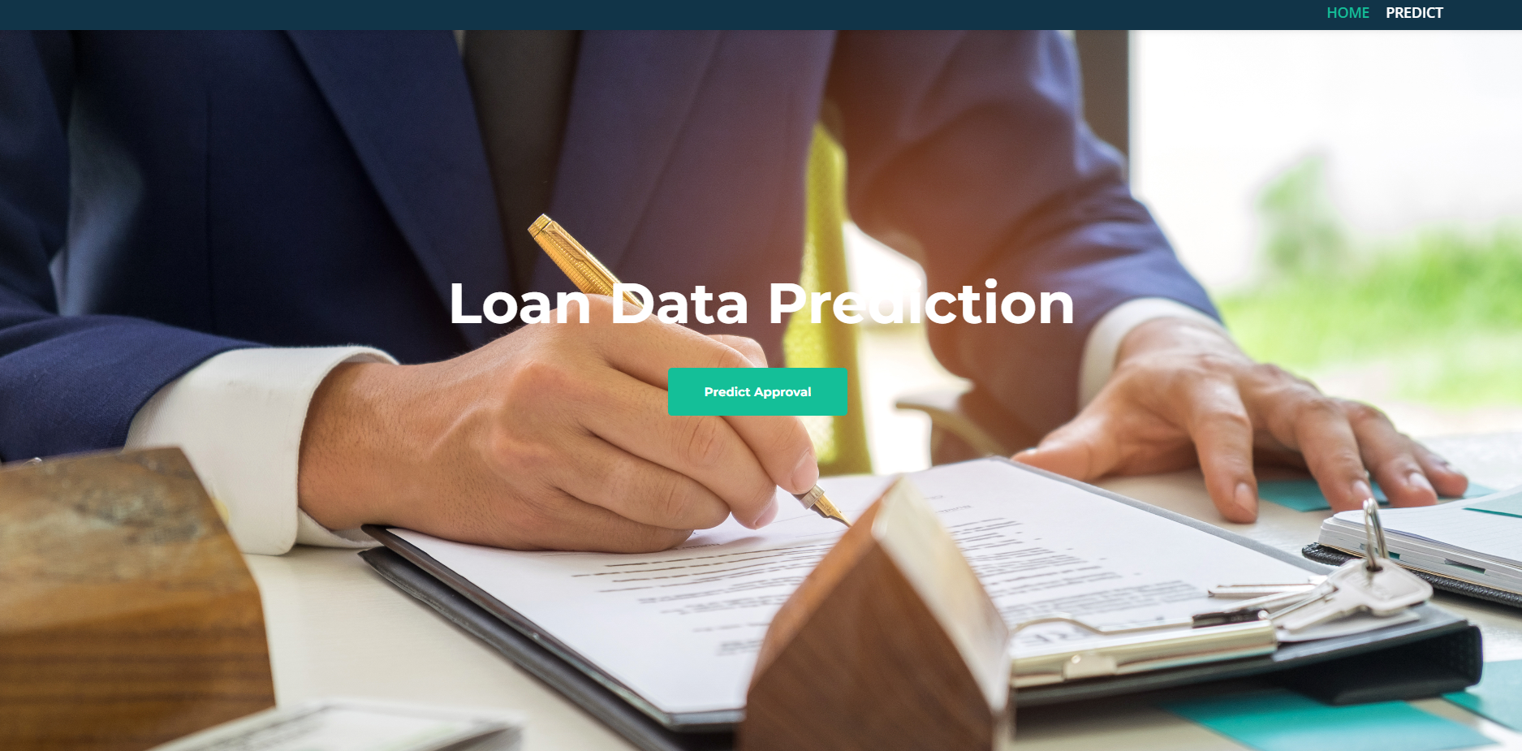
OUTPUT SCREENSHOTS
Home Page

Slide 34
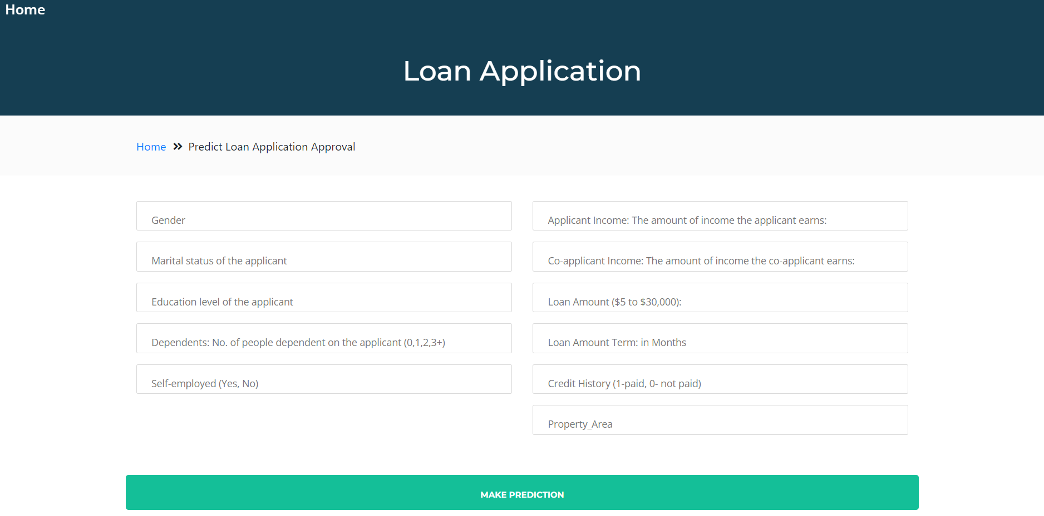
OUTPUT SCREENSHOTS
Application Page

Slide 35
SOFTWARE REQUIREMENTS
Operating system: Windows 7 or 10
Coding Language: python
Tool: Anaconda(spyder)
HARDWARE REQUIREMENTS
System : Pentium i3 Processor
Hard Disk : 300 GB(min)
Monitor : 15’’ LED
Input Devices : Keyboard, Mouse
Ram : 2 GB

Slide 36
References
[1] An Method for Predicting Loan Approval Using Machine Learning Algorithm, International Conference on Electronics and Sustainable Communication Systems (ICESC), M. Sheikh, A. Goel, and T. Kumar (2020).
[2] S. M. S. and R. Sunny T, "Loan Credibility Prediction System Based on Decision Tree Algorithm," International Journal of Engineering Research & Technology (IJERT), Vol. 4 Issue 09, (2015).
[3] "Loan Approval Prediction Based on Machine Learning Method," IOSR Journal of Computer Engineering, by A. Kumar, I. Garg, and S. Kaur (2016).
[4] "Clustering Loan Applicants based on Risk Percentage using K-Means Clustering Approaches," by Dr. K. Kavitha Issue 2 of Volume 6 of IJARCSSE (2016). 65–80 in Library, vol. 38, no. 1, 2020.

Slide 37
[5] "Prediction of Loan Status in Commercial Bank Using Machine Learning Classifier," Proceedings of the International Conference on Intelligent Sustainable Systems, G. Arutjothi and Dr. C. Senthamarai (2017).
[6] "Loan Prediction by Using Machine Learning Models," International Journal of Engineering and Technology, P. Supriya, M. Pavani, N. Saisushma, N. Kumari, and K. Vikas (2019).
[7] "HOME LOAN DATA ANALYSIS AND VISUALIZATION," International Journal of Creative Research Thinking (IJCRT), R. Salvi, R. Ghule, T. Sanadi, and M. Bhajibhakare (2021).
[8] "Domain-specific modification of a partial least squares regression model for loan defaults prediction," 11th IEEE International Conference on Data Mining Workshops, B. Srinivasan, N. Gnanasambandam, S. Zhao, and R. Minhas (2011).

Slide 38
[9] "Neural Networks for Prediction of Loan Default Using Attribute Relevance Analysis," International Conference on Signal Acquisition and Processing, M. V. Reddy and Dr. B. Kavitha (2010).
[10] Business-Oriented Feature Selection for Hybrid Classification Model of Credit Scoring, IEEE Second International Conference on Data Stream Mining & Processing, August G. Chornous, I. Nikolskyi (2018).

